Slide 1


Fulcrum
Senior Design Project
Group Members
Megan Rose Lee, Conor King, & Rishap Kumar
University of California Davis
Spring 2022
Notes:
1

Slide 2
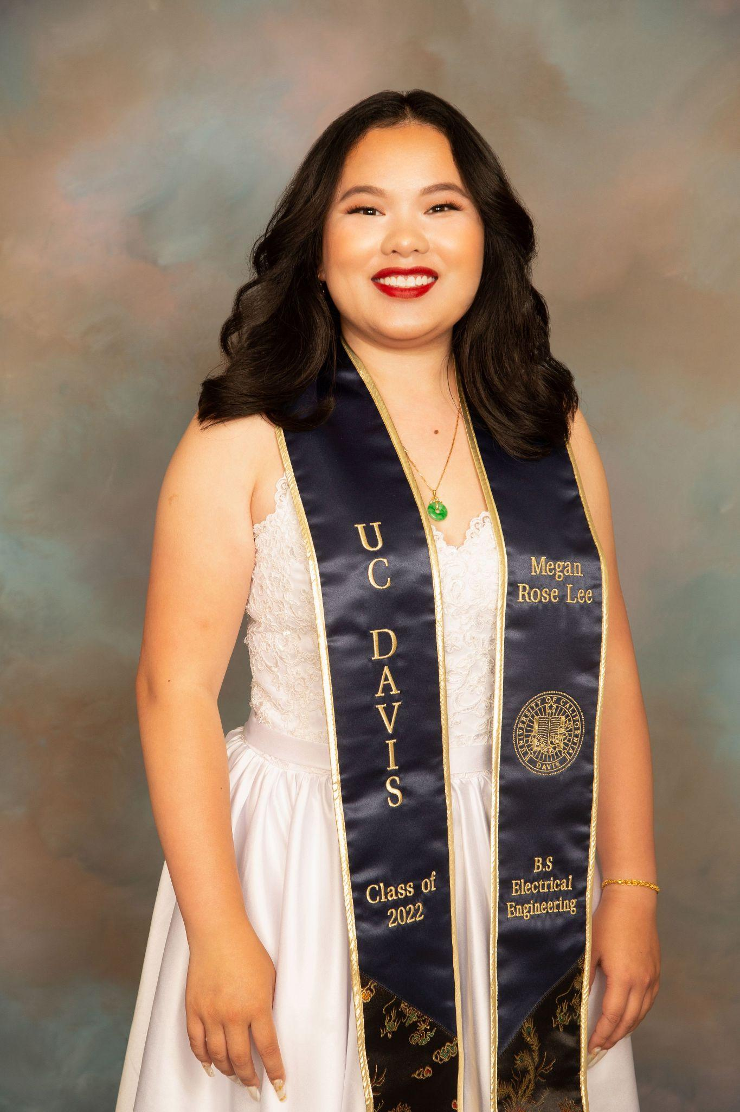


Team Members
Name: Megan Rose Lee
Major: Electrical Engineering
Name: Conor King
Major: Electrical Engineering
Name: Rishap Kumar
Major: Computer Engineering

Slide 3
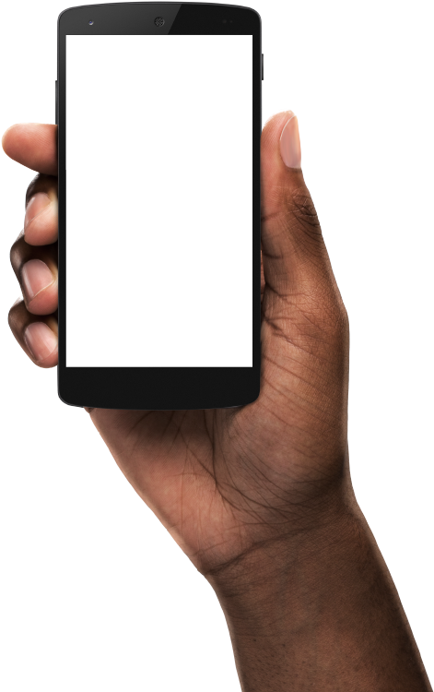
Fulcrum Overview:
Designed to carry out the task of office space and layout management.
Offices/work spaces are often revolved and changed depending on the need of individuals/workers.
Fulcrum is designed to guide workers to a usable office space that is customized to meet their needs.
Computer A
Computer A
1
Computer B
Rasberry Pi
Computer B
Computer C
3
2
Computer D
AWS
Computer C
Computer D
Computer’s tracking data sent to the raspberry pi
Rasberry pi runs machine learning to determine the exact location in the office space the computer is located
Information about devices’ location is sent to the app

Slide 4
Sensing, Computer, & Communication Requirement
Sensing | RFID detects user and sends information to AWS
Computing | Central hub (raspberry pi) stores machine learning training data and sends tracking information to AWS
Communication | Mobile phones and raspberry pi both communicate with AWS to provide user with up-to-date information on tag’s location

Slide 5
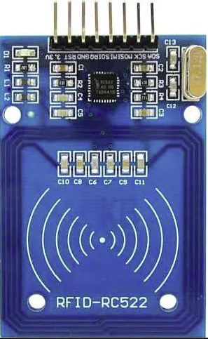
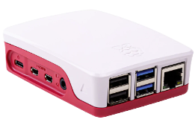
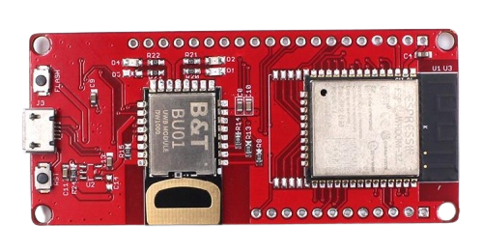
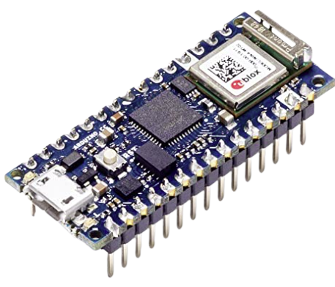
Project Hardware Components
Item | Quantity | Price per Unit
Raspberry Pi | 1 | $140
ESP32 Modules | 3 | $41.80
RFID Scanner | 1 | $5.49
Arduino Nano IoT | 1 | $28.99
Total |  | $299.88

Slide 6
Cloud Computing and Analytic Services
AWS
Dynamo DB
Lambda Functions
Cognitio
Amplify
Cloudwatch
IoT Core
SNS Notification
Machine Learning
Training
Tracking
App
Google Firebase SDK
Android Studio Java

Slide 7
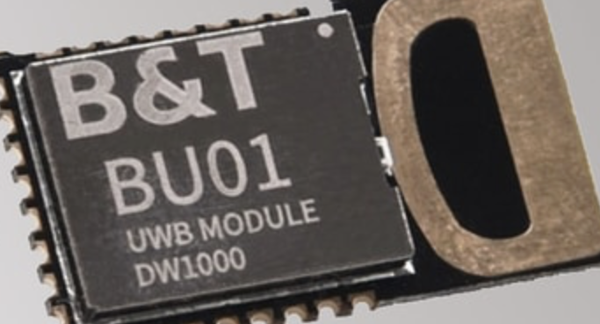
Range Sensing Technology
ESP32 Boards
DW1000 Chip enables Ultra Wideband
Short Pulses -> Large Bandwidth
More precise, less power than Bluetooth, WiFi
DW1000 Library
Notes:
One of Fulcrum’s core functionalities is allowing users to quickly and easily find items which move from place to place, such as lab equipment, laptops, or important office supplies. This tracking is accomplished with range sensing technology, and the hardware which makes it possible is the ESP32 Board.
The ESP32 board contains the DW1000, an Ultra Wideband transceiver chip. Each DW1000 chip can send out signals which are received by the other chips; based on the delay between sending the signal and receiving a response, each chip can calculate how far away the others are.
Rather than a continuous signal, Ultra Wideband consists of short pulses (which translate to a large bandwidth, hence the name). Range sensing using Ultra Wideband signals is more precise and requires less power than range sensing using Bluetooth or WiFi.
To communicate with the chip, we use the DW1000 Library, which contains functions to find the addresses and ranges of other active ESP32 Boards in the area.

Slide 8
Range Sensing System
Two Designations of ESP32 Board
Anchors
Stationary
Number determined by size of area
Tags
Mobile
Number determined by number of objects to be tracked.
Each Anchor receives Range Data of All Tags
Range Data is then transmitted via MQTT to the Raspberry Pi
3.87
1.21
1.14
3.22
Notes:
Our system consists of two types of chip: Anchors and Tags. Both types are ESP32 Boards; they differ only in the software they run.
Anchors are stationary; the number of anchors needed is determined by the size of the area you wish to track. The necessary anchor density varies from location to location, depending on the construction of the walls and other sources of interference.
The tags are mobile; each tag is associated with an item you wish to track.
Each anchor receives the range data of all tags and then transmits that information via MQTT to the Raspberry Pi for processing.

Slide 9
Training and Tracking
2 Phases
Training
For each distinct space in the area of interest
1 Tag is Moved Around
Every 2 seconds, Range Data for that Tag is sent from each Anchor to the Raspberry Pi
Saved to a CSV File
Result is a CSV File for each space or room, filled with characteristic range data
RandomForest Classifier
Fast, Lightweight and Simple
Notes:
The Fulcrum tracking system has two phases: a set-up phase called Training, and the running phase, called Tracking.
During training, the anchors are set up. In each distinct space in the area of interest (room 1, room 2, lab, conference room A; however your organization designates your spaces). In each space, a selected tag is moved around. Every two seconds, range data for that tag is sent by the anchors to the raspberry pi, which saves the data a CSV file. The result is a set of CSV files, one for each room, filled with range data characteristic of that room.
The raspberry Pi then trains a randomForest classifier on those CSV files.
The randomForest classfier was chosen because it is fast to train and lightweight; a more complex machine learning solution was unnecessary given the simplicity of the data.

Slide 10
Training and Tracking
2 Phases
Tracking
Periodically, Range Data for each Tag is sent from the Anchors to the Raspberry Pi
Trained Classifier predicts room
Prediction uploaded to DynamoDB database
App queries the database
Notes:
During tracking, the regular running of the system, range data for each tag is periodically sent from the anchors to the raspberry pi. How frequently is up to the administrator; typically every half-hour is more than often enough.
The trained classifier is loaded, predicts which room the tag is in based on its range data, and uploads the time, the tag’s id and its prediction to a DynamoDB database hosted on the AWS server.
When a user wishes to know where an item is, they simply use the app to select and refresh the item in question. The ap queries the database for the latest location of the item and prints the result.

Slide 11
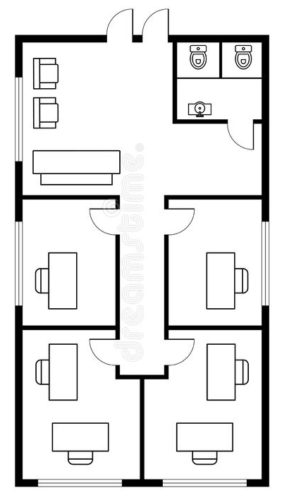
Advantages of Machine Learning
Typical Approach:
Create Floorplan
Use Trigonometry to find coordinates of Tag in environment
Determine location by comparing coordinates to floorplan
Cons of Typical Approach:
Floorplan requires complex GUI
Signal distortion from walls
Advantages of Our Approach using Machine Learning
No Floorplan Required
Sidesteps Distortion Issue
Notes:
A typical approach to creating this type of tracking system would involve creating a floorplan, then using trigonometry to find the coordinates of a tag in the environment based on its range data, and finally determining the location by comparing these coordinates to the floorplan. Creating the tools to enable the user to make this floorplan would add considerable complexity and size to the system, and it would require them to measure every wall of their space. Furthermore, distortion from the signal passing though the walls would likely increase the apparent distance between a tag and all anchors, leading to inaccurate locations, possibly locations which cannot be mapped to the floorplan. (Admittedly the use of UWB would mitigate this issue, as it is good at cutting through walls without distortion, but problems could still arise).
Using machine learning, there is no need for a floorplan nor the complex app to create one, and the distortion issue is bypassed entirely. As long as the distortion is relatively consistent, it will not matter; the classifier will learn to expect it and predict accordingly.

Slide 12
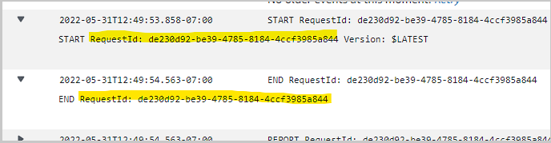
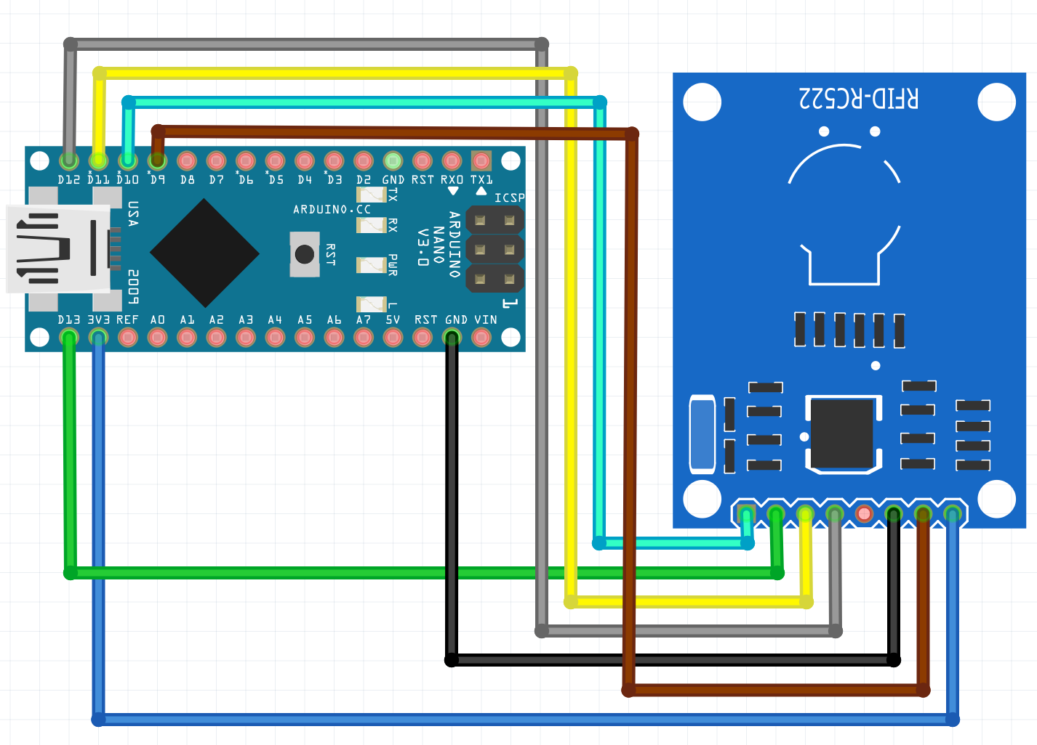
RFID Login and User tracking
Using the Arduino nano 33 IoT and RC522 we use to track Users entering a building and gather User data to monitor security and tracking demand all on AWS Cloud Watch.
To consider Security factors AWS connection is Using MQTT with Automated policy and rule set-up on AWS side. which only recognizes already entered RFID/NFC chips

Slide 13
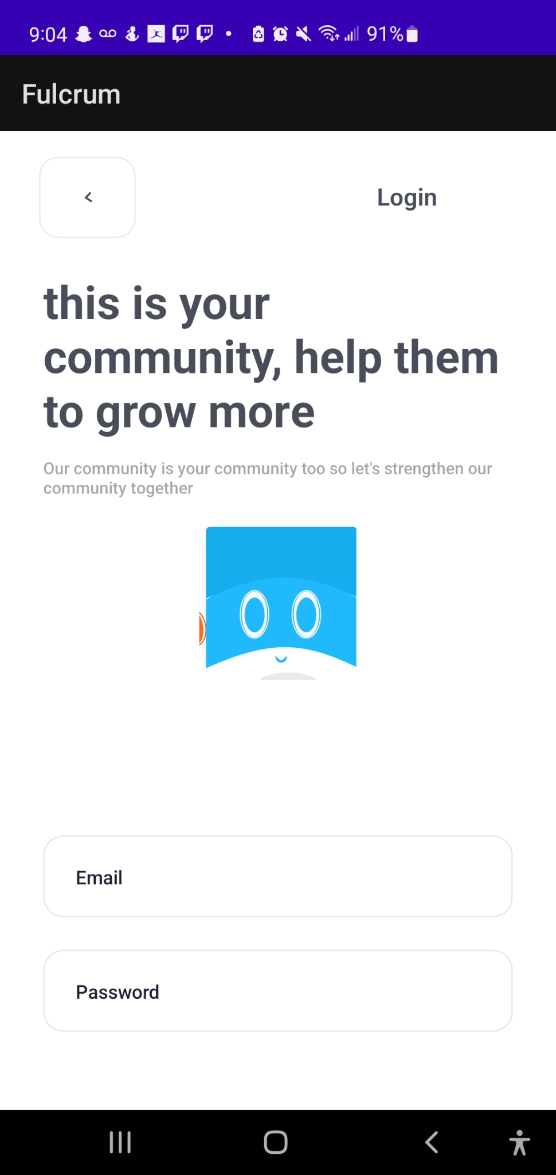
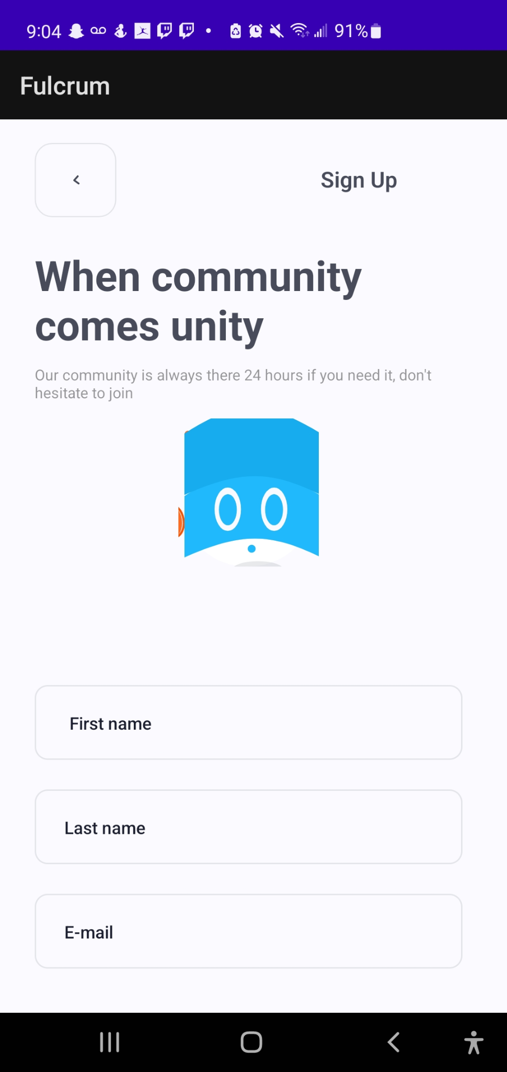
Mobile Interfacing Capability
Mobile Application
Uses RFID on phones to identify when a registered user enters a building data gets logged and displays workstations to the user. User can select a specific workspace to check out an ensure usage.

Slide 14
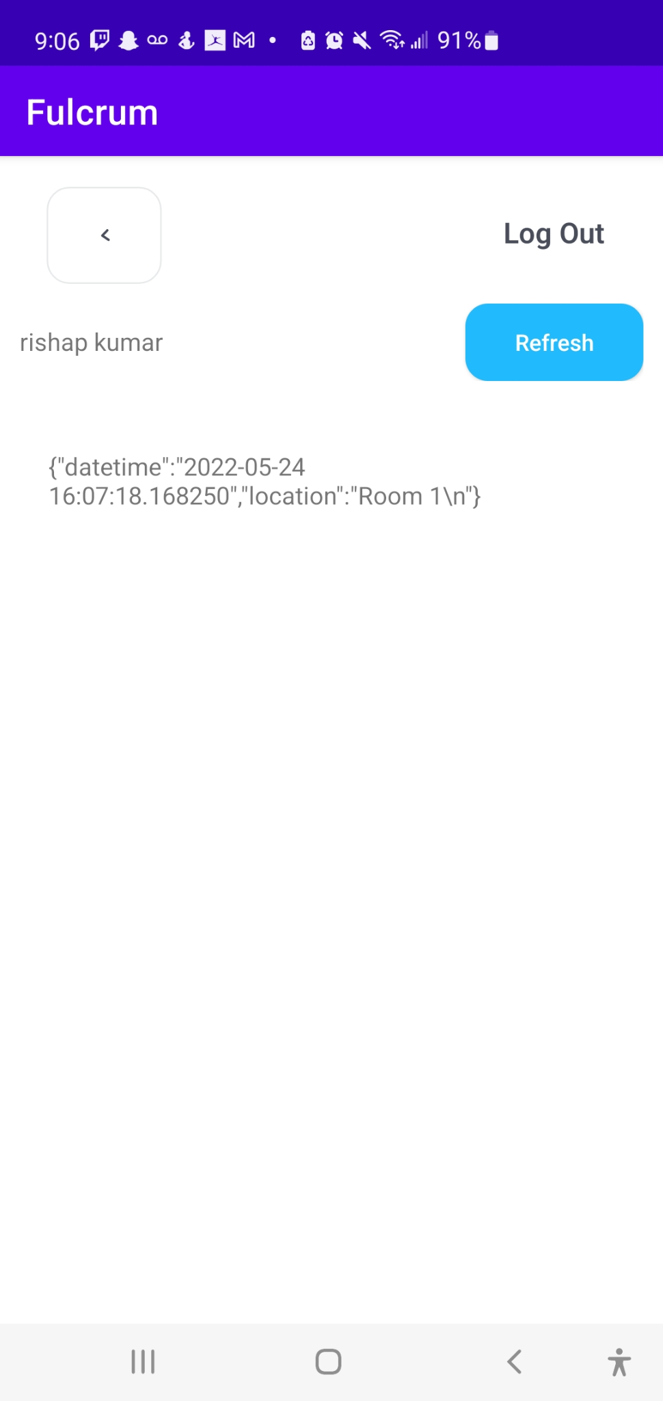

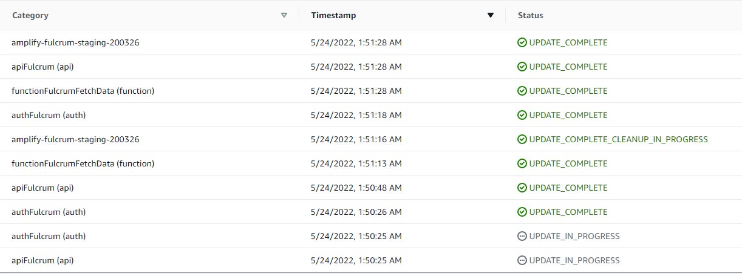

User Application
User’s sign up with their credentials and are required to set up multi-factor authorization via email
Once launching the application, users are able to view available tags and see their respective locations in correspondence to the trained data.

Slide 15
Improvements
Continuous Training for AI Improvement
Integrating Training into App, rather than standalone program on the Raspberry Pi
Power Management

Slide 16
Thank you!
Questions?

